Slide 1

AMAZON WEBSITE TESTING USING SELENIUM
B . Sailaja
EMP ID : 201327

Slide 2

CONTENTS : 1.Spring 2.selenium 3.junit 4.jenkins

Slide 3
Introduction
The project describes automation of Amazon Website using Spring Boot and Selenium Web Driver where test cases are verified using open source automation TestNg framework and Jenkins is used for Continuous Integration
The whole process is automated using Exclipse IDE.

Slide 4
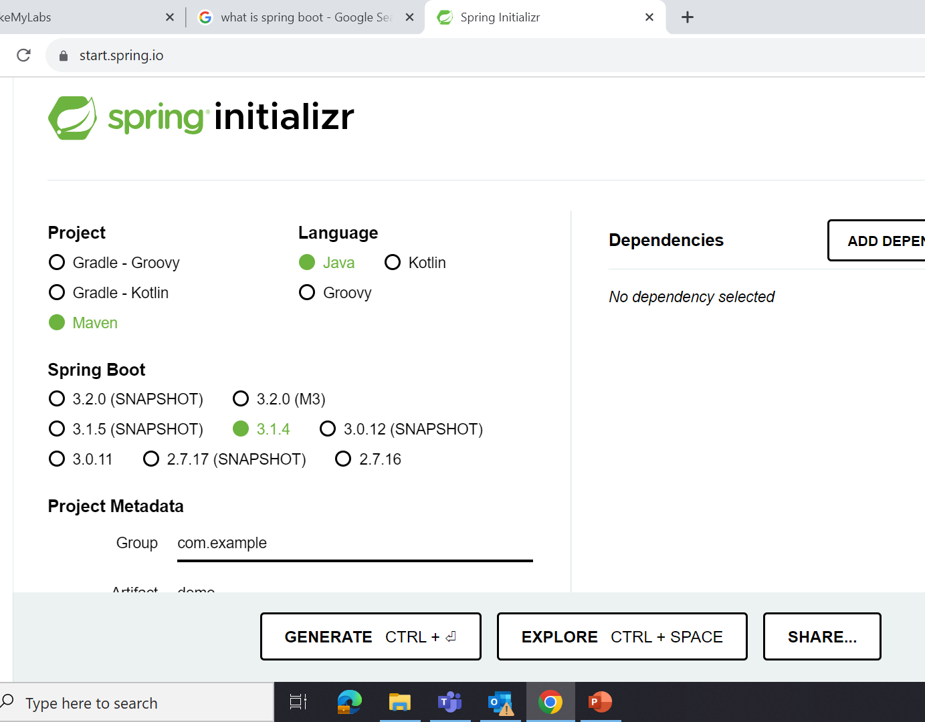
Spring Boot
open source Java-based framework
Built stand alone
Production ready
Run anywhere
No XML configuration

Slide 5
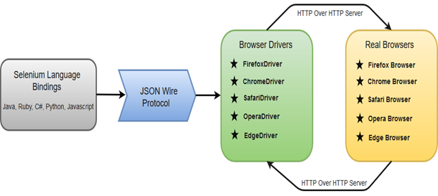
Selenium
Selenium WebDriver is a collection of open source APIs which are used to automate the testing of a web application
This Photo by Unknown Author is licensed under CC BY-SA

Slide 6
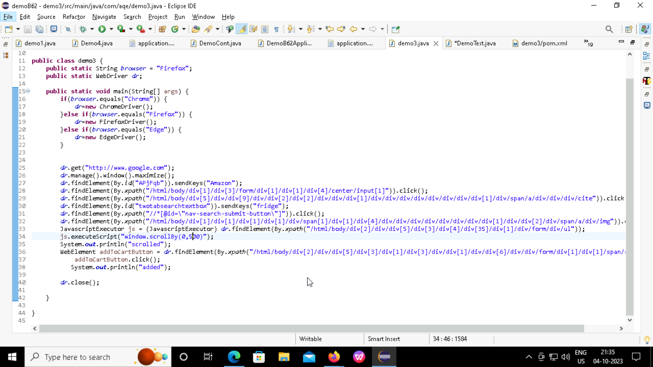

Slide 7
TestNg
It is an open source automated TestNG framework. In TestNG, NG stands for "Next Generation".
It provides you full control over the test cases and the execution of the test cases. Due to this reason, TestNG is also known as a testing framework
It is a testing framework inspired from JUnit and NUnit but introducing some new functionalities that make it more powerful and easier to use
It is designed to cover all categories of tests: unit, functional, end-to-end, integration, etc...
It framework eliminates the limitations of the older framework by providing more powerful and flexible test cases with help of easy annotations, grouping, sequencing and parametrizing.

Slide 8
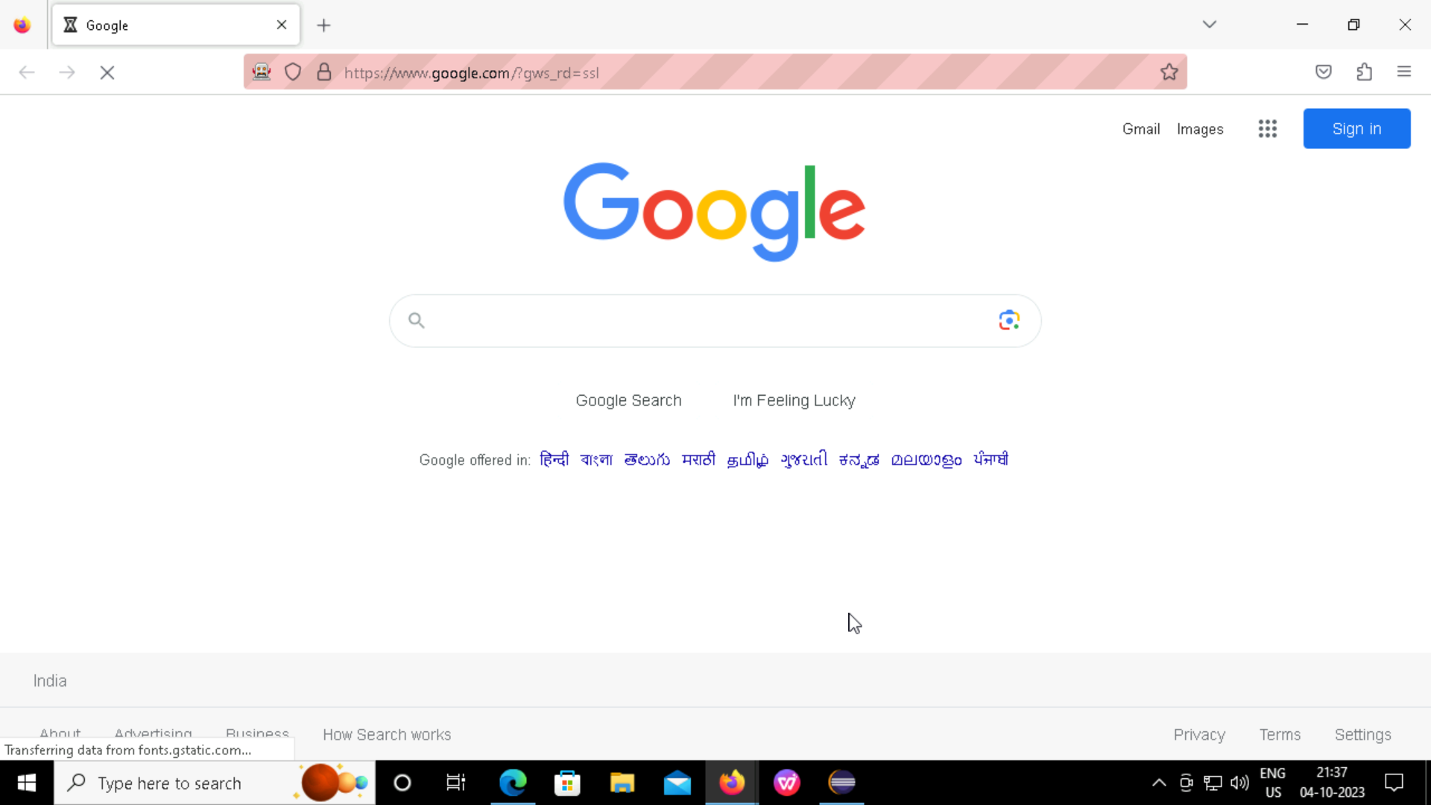
public class DemoTest { public static WebDriver dr; public static String browser = "Firefox"; @BeforeTest public void setUp() { if (browser.equals("Chrome")) { dr = new ChromeDriver(); } else if (browser.equals("Firefox")) { dr = new FirefoxDriver(); } dr.get("http://www.google.com"); dr.manage().window().maximize(); }

Slide 9
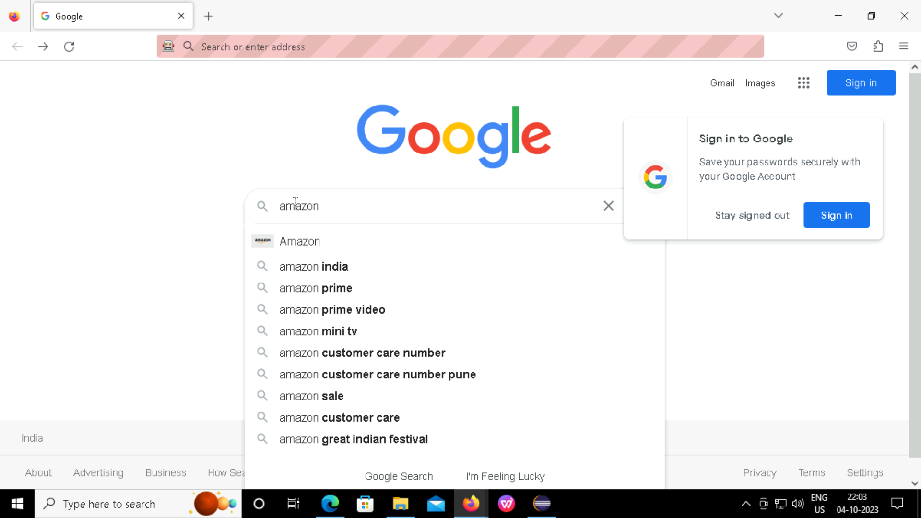
@Test(priority = 1) public void searchAmazon() { dr.findElement(By.id("APjFqb")).sendKeys("Amazon"); dr.findElement(By.xpath("/html/body/div[1]/div[3]/form/div[1]/div[1]/div[4]/center/input[1]")).click(); }

Slide 10
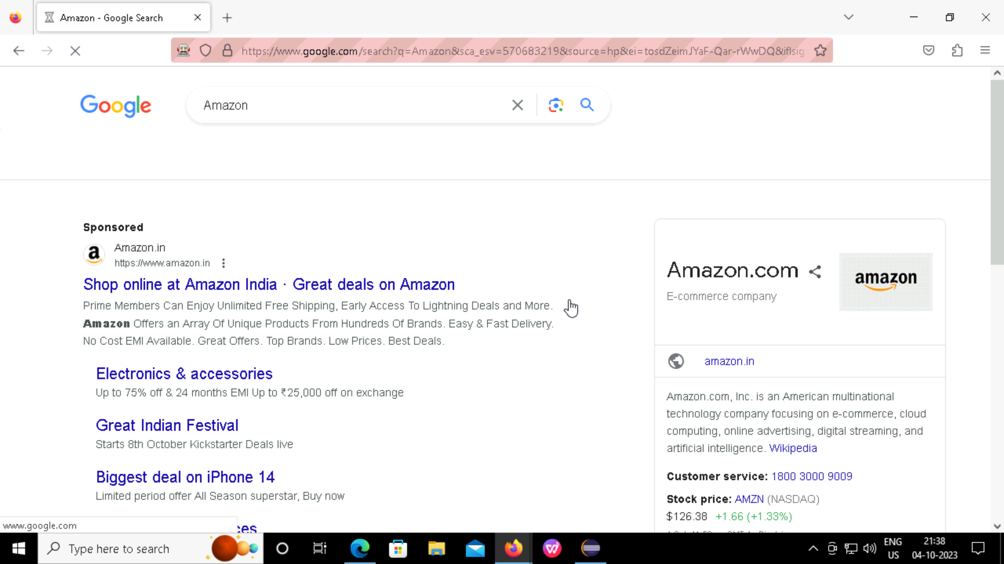
Test(priority = 2) public void clickAmazonLink() { dr.findElement(By.xpath("/html/body/div[5]/div/div[9]/div/div[2]/div[2]/div/div/div[1]/div/div/div/div/div/div/div/div[1]/div/span/a/div/div/div/cite")).click(); }

Slide 11
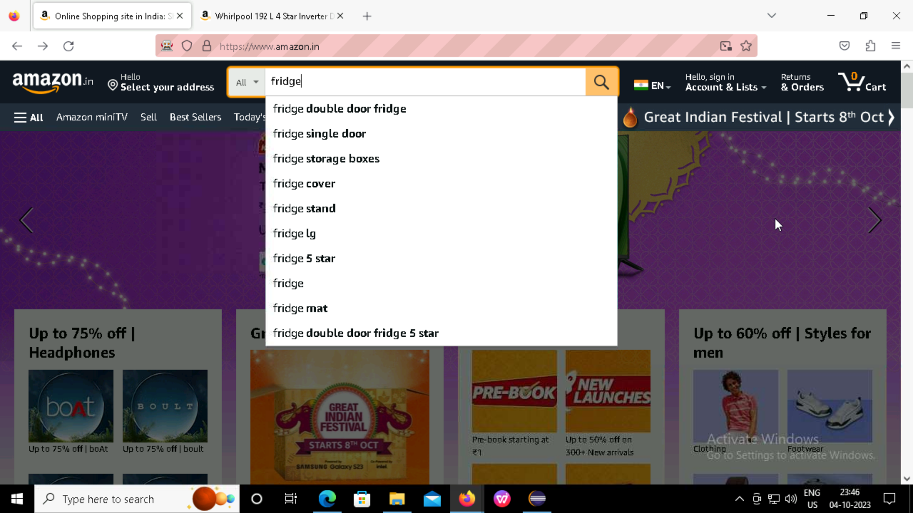
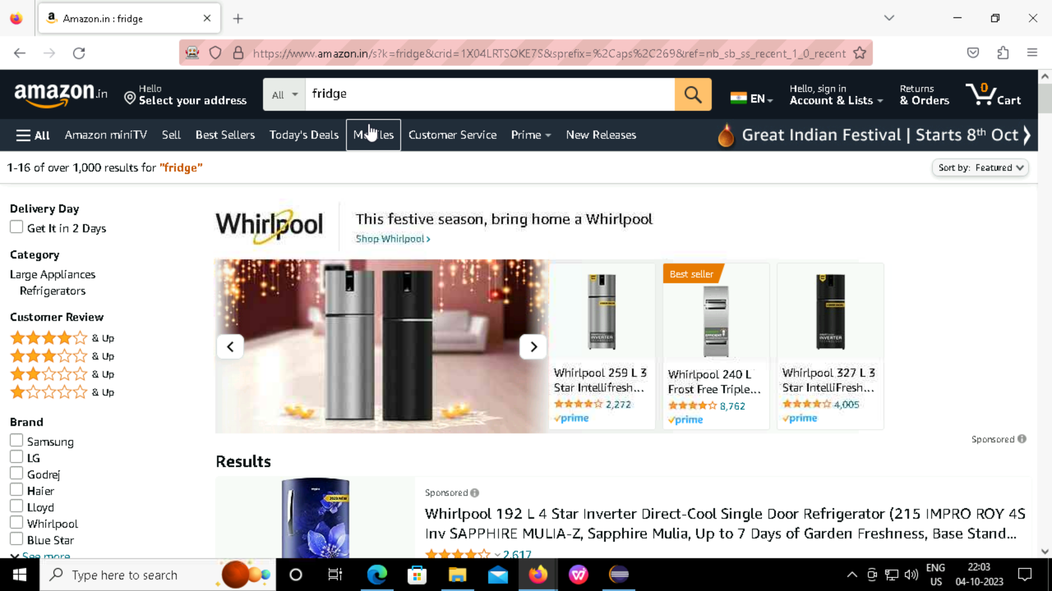
@Test(priority = 3) public void searchForFridge() { dr.findElement(By.id("twotabsearchtextbox")).sendKeys("fridge"); dr.findElement(By.cssSelector("#nav-search-submit-button")).click(); }

Slide 12
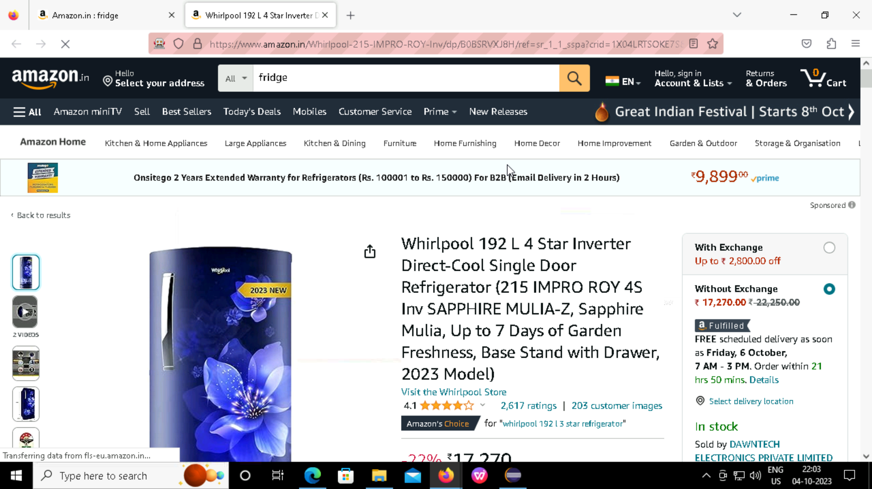
@Test(priority = 4) public void addToCart() { JavascriptExecutor js = (JavascriptExecutor) dr; js.executeScript("window.scrollBy(0,500)"); WebElement addToCartButton = dr.findElement(By.cssSelector("span.a-declarative a")); addToCartButton.click(); }

Slide 13
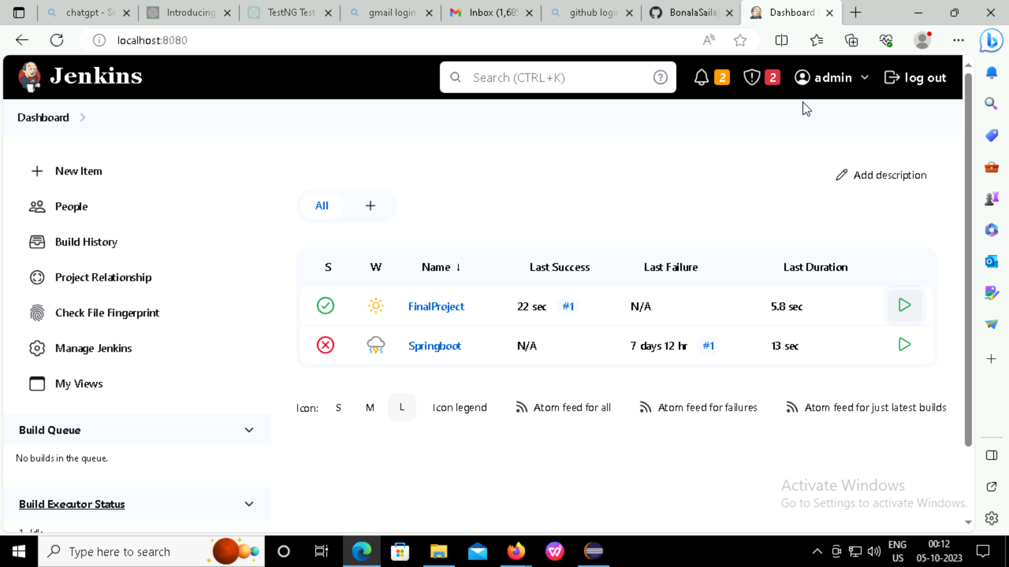
JENKINS
Jenkins is a Java-based open-source automation platform with plugins designed for continuous integration. It is used to continually create and test software projects, making it easier for developers and DevOps Engineers to integrate changes to the project and for consumers to get a new build.

Slide 14
THANK YOU

